Slide 1
Design and Analysis of Algorithms
CS602
Lecture 20
Network Flow – V
Polynomial time algorithms for Maximum Flow
Applications of Maximum Flow

Slide 2
Recap of the last lecture

Slide 3

Polynomial Time algorithm for max-flow
Algorithm 2
For Networks with edge capacities $∈R^{+}$

Slide 4

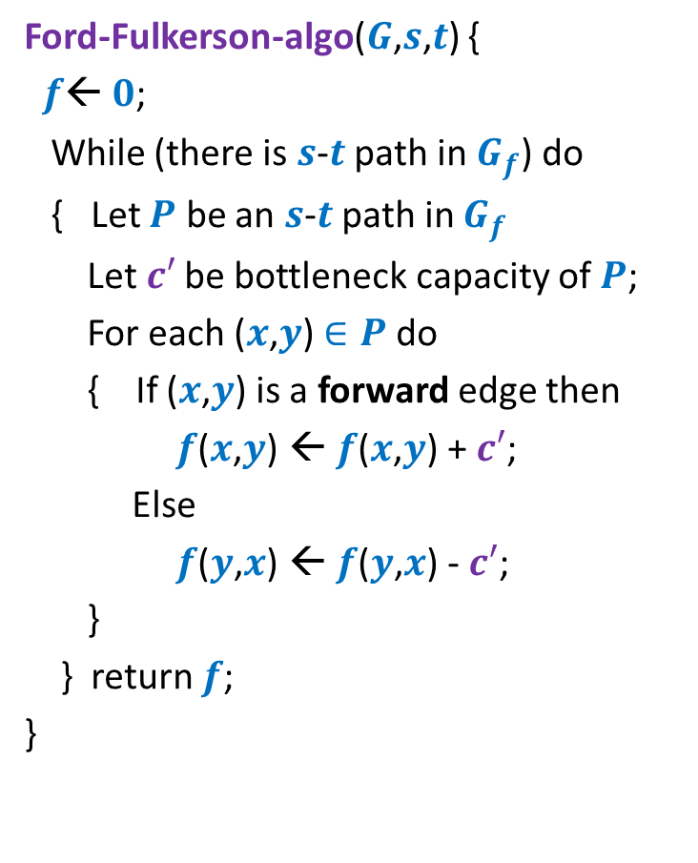

Ford Fulkerson Algorithm
Ford-Fulkerson-algo($G$,$s$,$t$) {
$f$← $0$;
While (there is $s$-$t$ path in $G_{f}$) do
{ Let $P$ be an $s$-$t$ path in $G_{f}$
Let$c′$ be bottleneck capacity of $P$;
For each ($x$,$y$) $∈P$ do
{ If ($x$,$y$) is a forward edge then
$f$($x$,$y$) ← $f$($x$,$y$) + $c′$;
Else
$f$($y$,$x$) ← $f$($y$,$x$) - $c′$;
}
} return $f$;
}
Observation:
In each iteration,
at least one edge disappears from $G_{f}$.
But it may appear in $G_{f}$ again.
How to modify the FF algorithm so that the number of times an edge disappears during the algorithm has a polynomial bound ?

Slide 5




Algorithm 2
Ford-Fulkerson-algo($G$,$s$,$t$) {
$f$← $0$;
While (there is $s$-$t$ path in $G_{f}$) do
{ Let $P$ be an $s$-$t$ path in $G_{f}$
Let$c′$ be bottleneck capacity of $P$;
For each ($x$,$y$) $∈P$ do
{ If ($x$,$y$) is a forward edge then
$f$($x$,$y$) ← $f$($x$,$y$) + $c′$;
Else
$f$($y$,$x$) ← $f$($y$,$x$) - $c′$;
}
} return $f$;
}
Algorithm-2($G$,$s$,$t$) {
➔
An edge can disappear and re-appear O($n$) times.
Let $P$ be the shortest $s$-$t$ path in $G_{f}$;
How to prove:
An edge can disappear and re-appear O($n$) times.

Slide 6









A crucial Insight
Lemma 1 :
Distance from $s$ to each vertex in $G_{f}$increases monotonically during the algorithm.
$$δ_{f′}\left(s,x\right)≥δ_{f}\left(s,x\right)$$
$$δ_{f}(s,x)$$
$$s$$
$$t$$
$$x$$
$$G_{f}$$
After $i$th Iteration
$$δ_{f′}(s,x)$$
$$s$$
$$t$$
$$G_{f′}$$
$$x$$

Slide 7

Edges in Residual Network $G_{f}$
Forward Edge
Any Edge
Backward Edge

Slide 8








Disappearance of an edge
➔ ($x$,$y$) must belong to the path $P$ selected during $i$th Iteration.
$$s$$
$$t$$
$$G_{f}$$
$$x$$
$$y$$
After $i$th Iteration
$$s$$
?
$$t$$
$$G_{f′}$$
$$x$$
$$y$$

Slide 9






(Re)-Appearance of an edge
➔ ($y$,$x$) must belong to the path $P$ selected during $i$th Iteration.
$$s$$
$$t$$
$$G_{f}$$
$$x$$
$$y$$
After $i$th Iteration
$$s$$
$$t$$
$$G_{f′}$$
$$x$$
$$y$$

Slide 10





Journey of an edge
$$P$$
$$G_{f}$$
$$s$$
$$t$$
$$x$$
$$y$$
After $i$th Iteration
$$s$$
$$t$$
$$x$$
$$y$$

Slide 11
Journey of an edge
$$P$$
$$G_{f}$$
$$s$$
$$t$$
$$x$$
$$y$$
After $i$th Iteration
$$s$$
$$t$$
$$x$$
$$y$$

Slide 12








Journey of an edge
$$P$$
$$G_{f}$$
$$s$$
$$t$$
$$δ_{f}\left(s,y\right)=δ_{f}\left(s,x\right)+1$$
$$x$$
$$y$$
After $i$th Iteration
Using Lemma 1
$$s$$
$$t$$
$$δ_{f′}\left(s,y\right)≥δ_{f}\left(s,y\right)$$
$$x$$
$$y$$
$$P′$$
$$G_{f′}$$
$$s$$
$$t$$
$$δ_{f′}\left(s,x\right)=δ_{f′}\left(s,y\right)+1$$
$$x$$
$$y$$
$$≥δ_{f}\left(s,y\right)+1$$
After $j$th Iteration
$${=δ}_{f}\left(s,x\right)+2$$
$$s$$
$$t$$
$$x$$
$$y$$

Slide 13
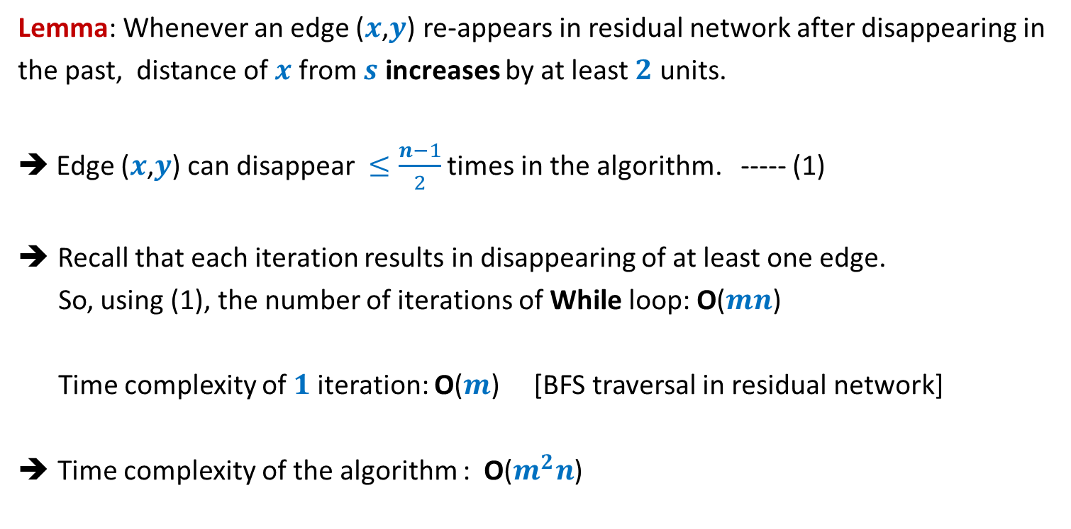
Analysis of Algorithm 2
Lemma: Whenever an edge ($x$,$y$) re-appears in residual network after disappearing in
the past, distance of $x$ from $s$ increases by at least $2$ units.
➔ Edge ($x$,$y$) can disappear $≤\frac{n−1}{2}$ times in the algorithm. ----- (1)
Recall that each iteration results in disappearing of at least one edge.
So, using (1), the number of iterations of While loop: O($mn$)
Time complexity of $1$iteration: O($m$) [BFS traversal in residual network]
Time complexity of the algorithm : O($m^{2}n$)

Slide 14
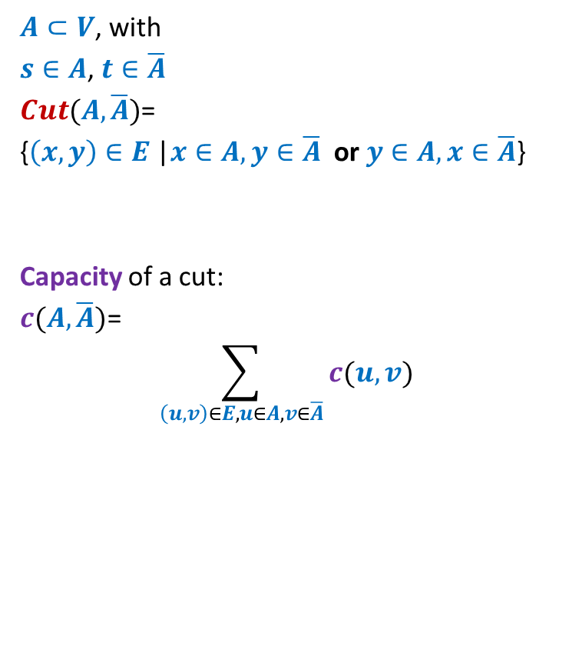
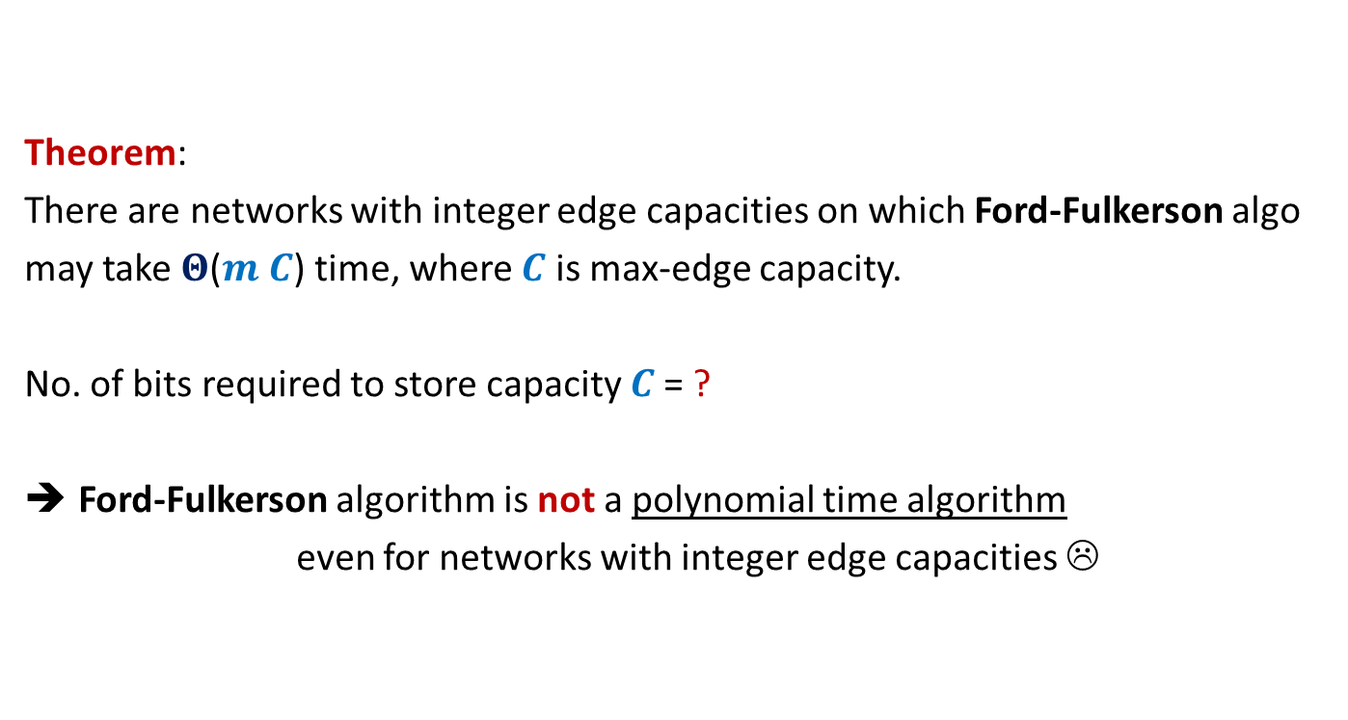

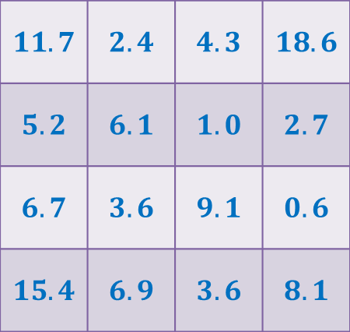

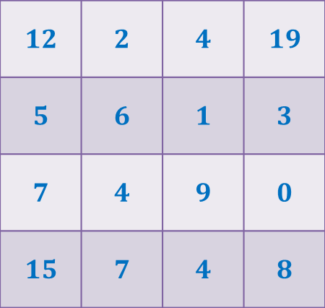
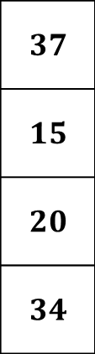
Rounding of a matrix
$$11$$
$$11.7$$
$$12$$
$$39$$ | $$19$$ | $$18$$ | $$30$$
$$37$$
$$15$$
$$20$$
$$34$$
$$11.7$$ | $$2.4$$ | $$4.3$$ | $$18.6$$
$$5.2$$ | $$6.1$$ | $$1.0$$ | $$2.7$$
$$6.7$$ | $$3.6$$ | $$9.1$$ | $$0.6$$
$$15.4$$ | $$6.9$$ | $$3.6$$ | $$8.1$$
$$12$$ | $$2$$ | $$4$$ | $$19$$
$$5$$ | $$6$$ | $$1$$ | $$3$$
$$7$$ | $$4$$ | $$9$$ | $$0$$
$$15$$ | $$7$$ | $$4$$ | $$8$$
Rounding always exists !
Rounding can be computed efficiently.
It was a homework.

Slide 15

Rounding of a matrix
Tool 1: Integrality of max-flow
Tool 2: An elementary observation
Max-Flow can not decrease if we increase the capacity of any set of edges.
Tool 3: A simple Homework exercise
If each matrix with entries $∈[0,1]$ can be rounded,
then each matrix can be rounded.

Slide 16



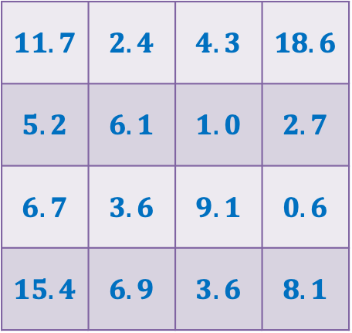


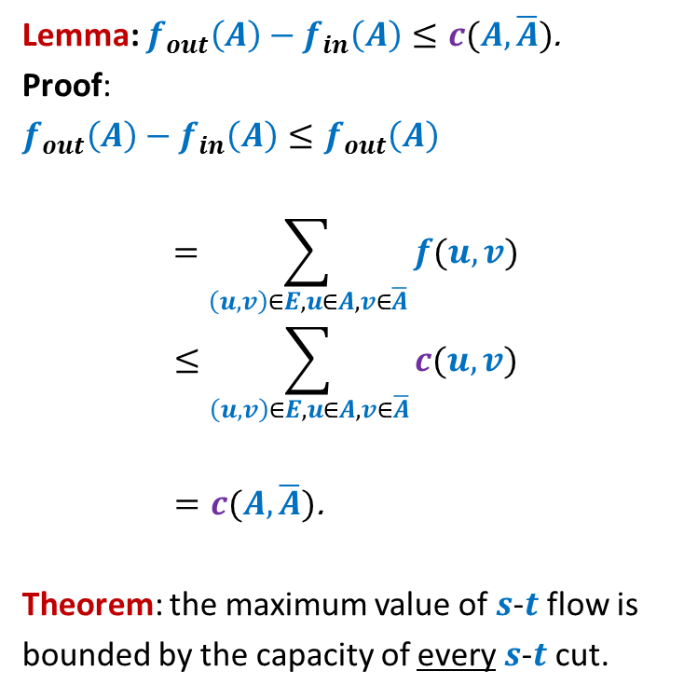








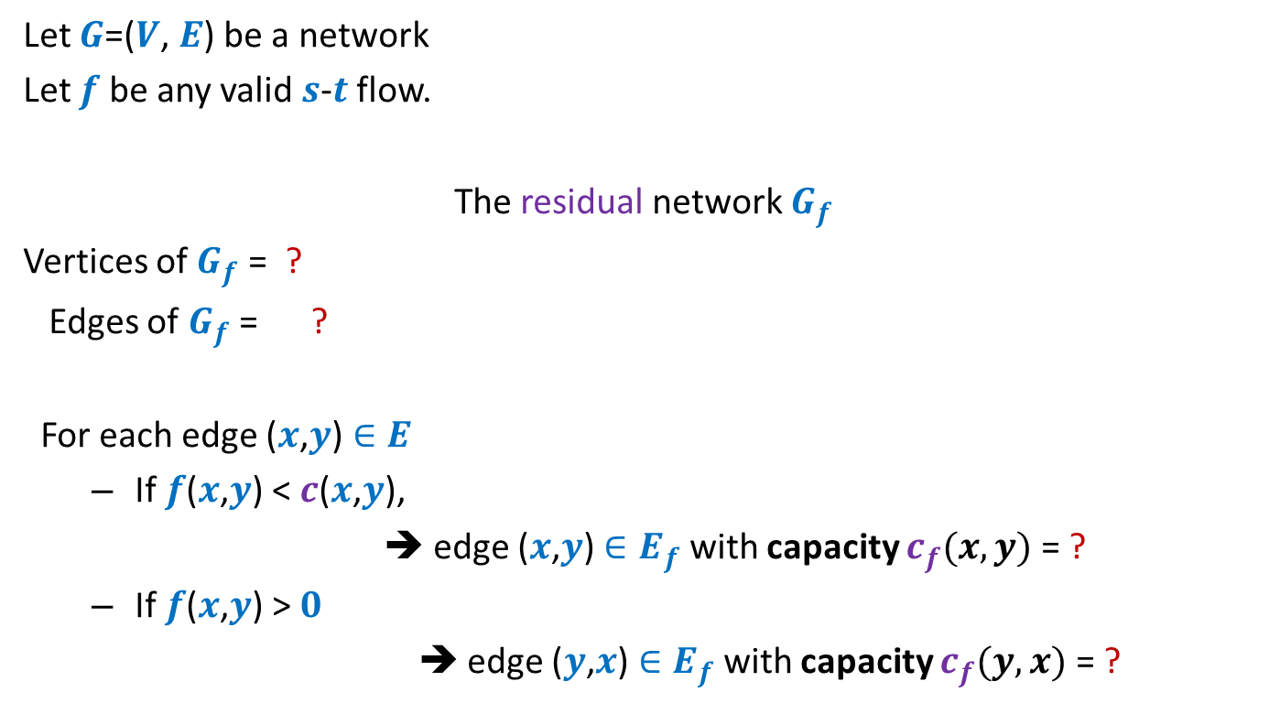
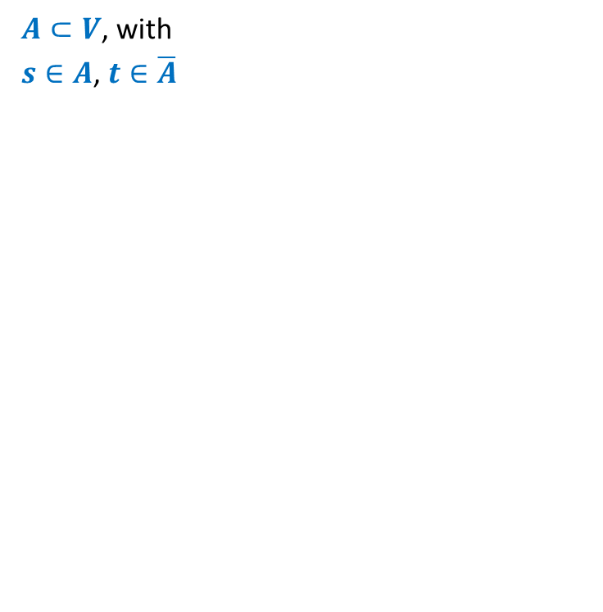

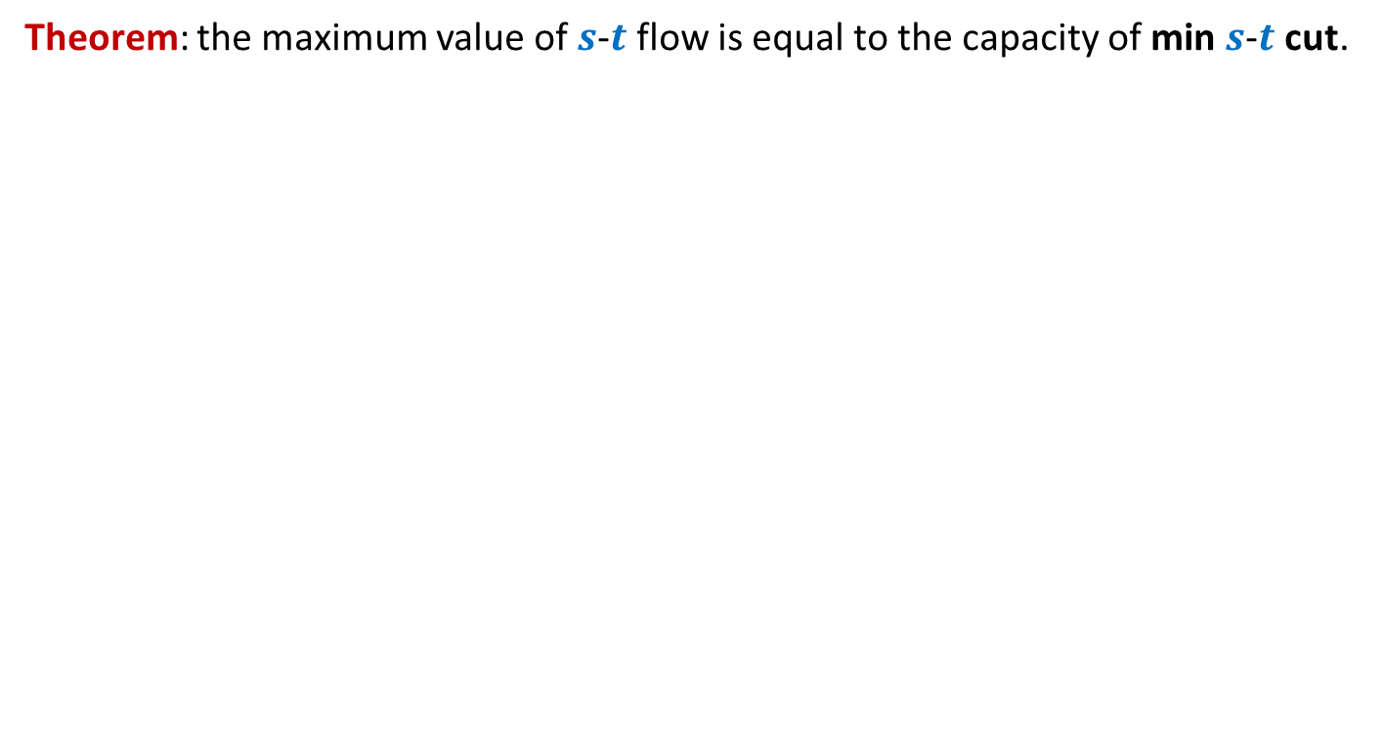

Rounding of a matrix
$$0$$
$$0.7$$
$$1$$
Tool 3
Tool 2
$$2$$ | $$2$$ | $$1$$ | $$2$$
Tool 1
rows
columns
$$11.7$$ | $$2.4$$ | $$4.3$$ | $$18.6$$
$$5.2$$ | $$6.1$$ | $$1.0$$ | $$2.7$$
$$6.7$$ | $$3.6$$ | $$9.1$$ | $$0.6$$
$$15.4$$ | $$6.9$$ | $$3.6$$ | $$8.1$$
$$2$$
$$1$$
$$2$$
$$2$$
$$0.7$$ | $$0.4$$ | $$0.3$$ | $$0.6$$
$$0.2$$ | $$0.1$$ | $$0.0$$ | $$0.7$$
$$0.7$$ | $$0.6$$ | $$0.1$$ | $$0.6$$
$$0.4$$ | $$0.9$$ | $$0.6$$ | $$0.1$$
$$1$$
$$0.2$$
$$2$$
$$2$$
$$1$$
$$0.1$$
$$2$$
$$1$$
$$0$$
$$2$$
$$0.0$$
$$1$$
$$0.7$$
$$1$$
$$2$$
$$2$$
What is the maximum flow in this network ?
$$7$$
Homework: Reproduce precise arguments we discussed in class on your own

Slide 17
Proof of the monotonic increase of distanceS in residual network
Homework

Slide 18
Application of Max-Flow
Bipartite Matching

Slide 19
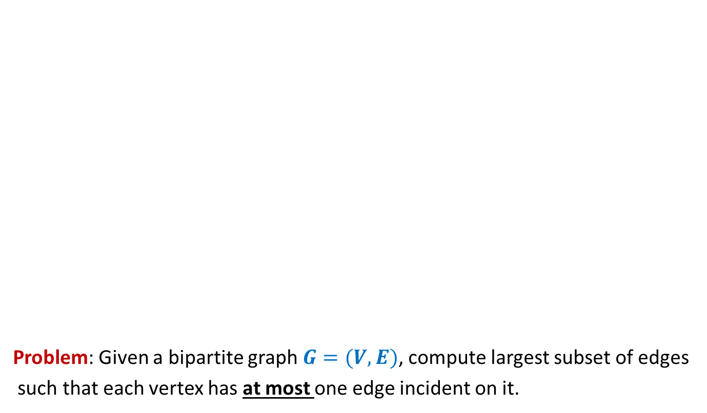
Bipartite matching
Problem: Given a bipartite graph $G=(V,E)$, compute largest subset of edges
such that each vertex has at most one edge incident on it.
applicants
jobs
Matching of size 5
Matching of size 3

Slide 20







Bipartite matching Maximum Flow
applicants
jobs
$$1$$
$$1$$
$$1$$
$$1$$
$$1$$
$$1$$
$$1$$
$$1$$
$$G′$$
$$s$$
$$1$$
$$t$$
$$1$$
$$1$$
$$1$$
$$1$$
$$1$$
$$1$$
$$1$$
$$1$$
$$1$$
$$1$$
$$1$$
$$1$$
$$1$$
$$1$$
How does the max-flow instance look like ?

Slide 21






Bipartite matching Maximum Flow
?
Theorem: There is a
there is a
applicants
jobs
$$1$$
$$1$$
$$1$$
$$1$$
$$1$$
$$1$$
$$1$$
$$1$$
$$G′$$
$$s$$
$$1$$
$$t$$
$$1$$
$$1$$
$$1$$
$$1$$
$$1$$
$$1$$
$$1$$
What is the relation between the two instances ?
$$1$$
$$1$$
$$1$$
$$1$$
$$1$$
$$1$$
$$1$$
maximum
matching of size $k$ in $G$ if and only if
maximum
$s$-$t$ flow of value $k$ in $G′$.

Slide 22
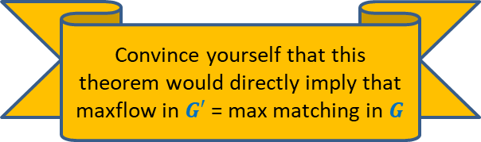


Bipartite matching Maximum Flow
?
Theorem: There is a
there is a
Convince yourself that this theorem would directly imply that
maxflow in $G′$ = max matching in $G$
applicants
jobs
$$1$$
$$1$$
$$1$$
$$1$$
$$1$$
$$1$$
$$1$$
$$1$$
$$G′$$
$$s$$
$$1$$
$$t$$
$$1$$
$$1$$
$$1$$
$$1$$
$$1$$
$$1$$
$$1$$
$$1$$
$$1$$
$$1$$
$$1$$
$$1$$
$$1$$
$$1$$
matching of size $k$ in $G$ if and only if
$s$-$t$ flow of value $k$ in $G′$.

Slide 23

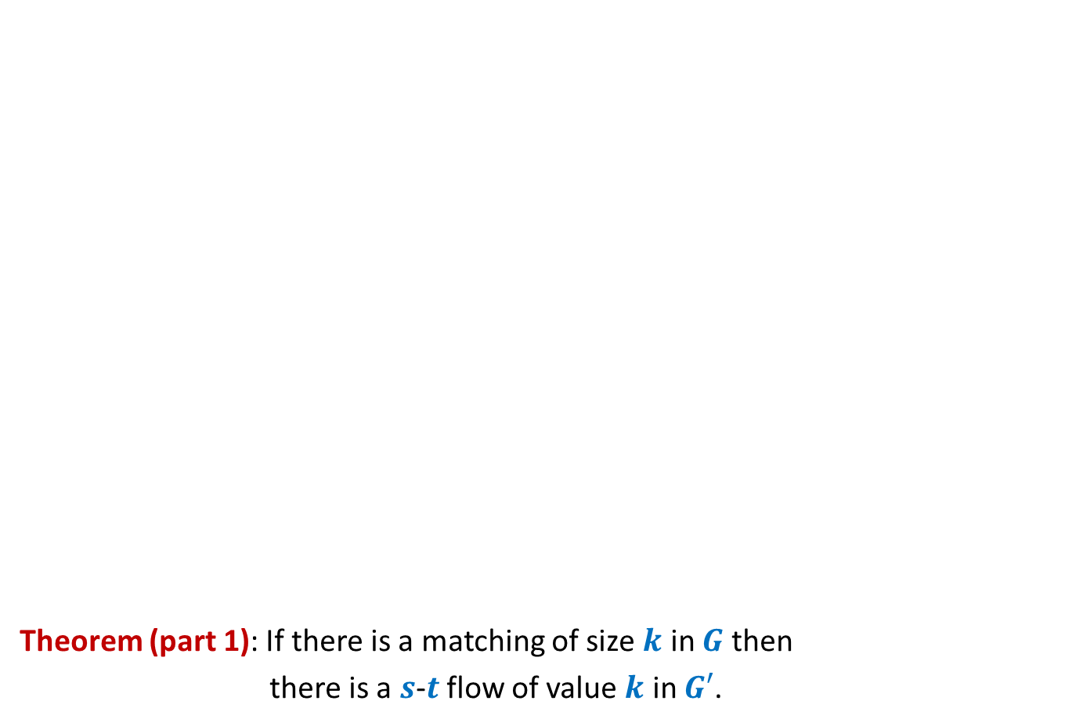
Bipartite matching Maximum Flow
?
Theorem (part 1): If there is a matching of size $k$ in $G$ then
there is a $s$-$t$ flow of value $k$ in $G′$.
applicants
jobs
$$1$$
$$1$$
$$1$$
$$1$$
$$1$$
$$1$$
$$1$$
$$1$$
$$G′$$
$$s$$
$$1$$
$$t$$
$$1$$
$$1$$
$$1$$
$$1$$
$$1$$
$$1$$
$$1$$
$$1$$
$$1$$
$$1$$
$$1$$
$$1$$
$$1$$
$$1$$

Slide 24
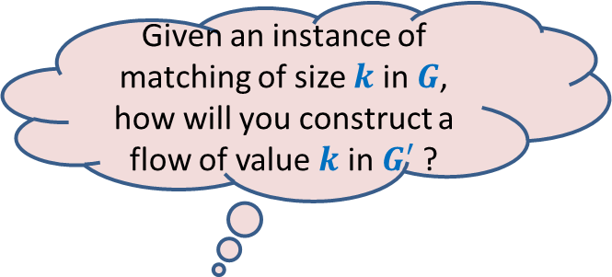

Bipartite matching Maximum Flow
?
Theorem (part 1): If there is a matching of size $k$ in $G$ then
there is a $s$-$t$ flow of value $k$ in $G′$.
Given an instance of matching of size $k$ in $G$, how will you construct a flow of value $k$ in $G′$ ?
applicants
jobs
$$1$$
$$1$$
$$1$$
$$1$$
$$1$$
$$1$$
$$1$$
$$1$$
$$G′$$
$$s$$
$$1$$
$$t$$
$$1$$
$$1$$
$$1$$
$$1$$
$$1$$
$$1$$
$$1$$
$$1$$
$$1$$
$$1$$
$$1$$
$$1$$
$$1$$
$$1$$
$$1$$

Slide 25
Bipartite matching Maximum Flow
?
Theorem (part 1): If there is a matching of size $k$ in $G$ then
there is a $s$-$t$ flow of value $k$ in $G′$.
applicants
jobs
$$1$$
$$1$$
$$1$$
$$1$$
$$1$$
$$1$$
$$1$$
$$1$$
$$G′$$
$$s$$
$$1$$
$$t$$
$$1$$
$$1$$
$$1$$
$$1$$
$$1$$
$$1$$
$$1$$
$$1$$
$$1$$
$$1$$
$$1$$
$$1$$
$$1$$
$$1$$
$$1$$

Slide 26
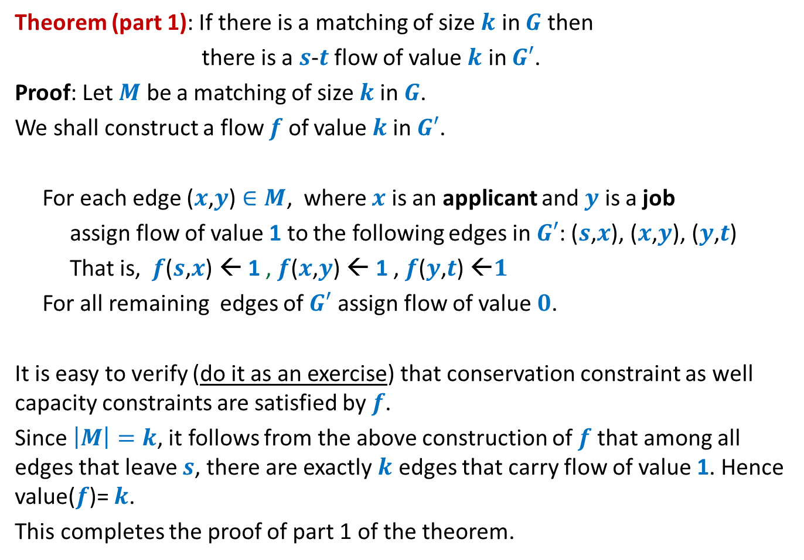
Theorem (part 1): If there is a matching of size $k$ in $G$ then
there is a $s$-$t$ flow of value $k$ in $G′$.
Proof: Let $M$ be a matching of size $k$in $G$.
We shall construct a flow $f$ of value $k$in $G′$.
For each edge ($x$,$y$) $∈M$, where $x$ is an applicant and $y$ is a job
assign flow of value 1 to the following edges in $G′$: ($s$,$x$), ($x$,$y$), ($y$,$t$)
That is, $f$($s$,$x$) ← 1 , $f$($x$,$y$) ← 1 , $f$($y$,$t$) ←$1$
For all remaining edges of $G′$ assign flow of value $0$.
It is easy to verify (do it as an exercise) that conservation constraint as well capacity constraints are satisfied by $f$.
Since $\left|M\right|=k$, it follows from the above construction of $f$that among all edges that leave $s$, there are exactly $k$ edges that carry flow of value 1. Hence value($f$)= $k$.
This completes the proof of part 1 of the theorem.

Slide 27
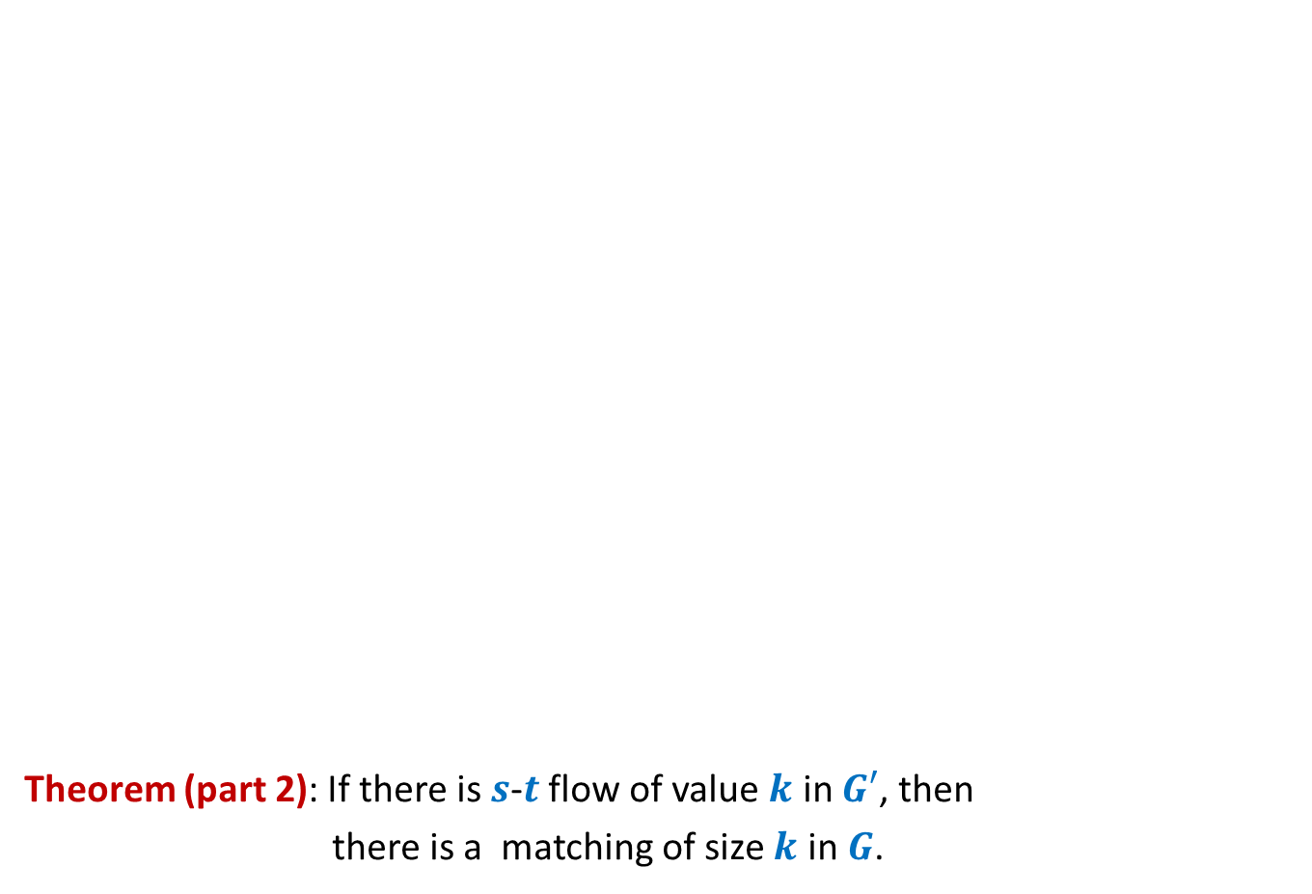


Bipartite matching Maximum Flow
Theorem (part 2): If there is $s$-$t$ flow of value $k$ in $G′$, then
there is a matching of size $k$ in $G$.
Given an instance of flow of value $k$ in $G′$, how will you construct a matching of size $k$ in $G$ ?
Integrality of flow
applicants
jobs
$$1$$
Unit edge capacity
$$1$$
$$1$$
$$1$$
$$1$$
$$1$$
$$1$$
$$A$$
$$1$$
$$G′$$
$$s$$
$$1$$
$$t$$
$$1$$
$$1$$
$$1$$
$$1$$
$A$= {$s$} $∪$ Applicants
$$1$$
$$1$$
$$1$$
$$1$$
$$1$$
$$1$$
$$1$$
$$1$$
Complete the proof with these pointer and verify with the proof given in the following slide.
$f_{out}\left(A\right)−f_{in}(A)$ = $k$
$$1$$
$$1$$
$$0$$
$$1$$

Slide 28
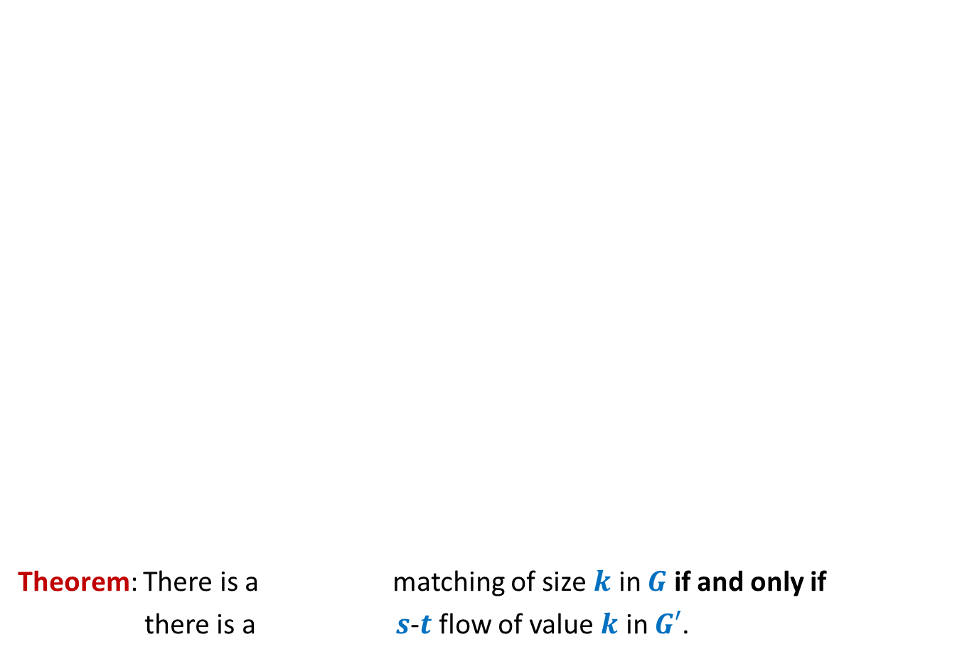
Theorem (part 2): If there is $s$-$t$ flow of value $k$ in $G′$, then
there is a matching of size $k$ in $G$.
Proof: Let $f$ be a $s$-$t$ flow of value $k$ in $G′$.
We shall now construct a matching of size $k$ in $G$.
Firstly, by integrality theorem, $f$ is integral.
Consider the set $A$= {$s$} $∪$ Applicants
So $f_{out}\left(A\right)−f_{in}(A)$ = $k$
Since there is no edge that enters $A$, so $f_{in}(A)$ = $0$,
Hence $f_{out}\left(A\right)$ = $k$.
Moreover, since capacity of each edge in $G′$ is $1$, each edge in $G′$ carries either no flow or a flow of value $1$.
Therefore, there are exactly $k$ edges between Applicants and jobs that carry flow of value $1$.
Let $M$ denote the set of these $k$ edges.
Since each edge leaving $s$ (and each edge entering $t$) has capacity $1$, there can be at most one edge from $M$incident on any applicant (or any job).
It thus follows that the set $M$is indeed a matching in $G$.
This completes the proof of part 2 of the theorem.

Slide 29

Application # 2 of Max-Flow
Maximum no. of Edge Disjoint paths from $s$ to $t$

Slide 30
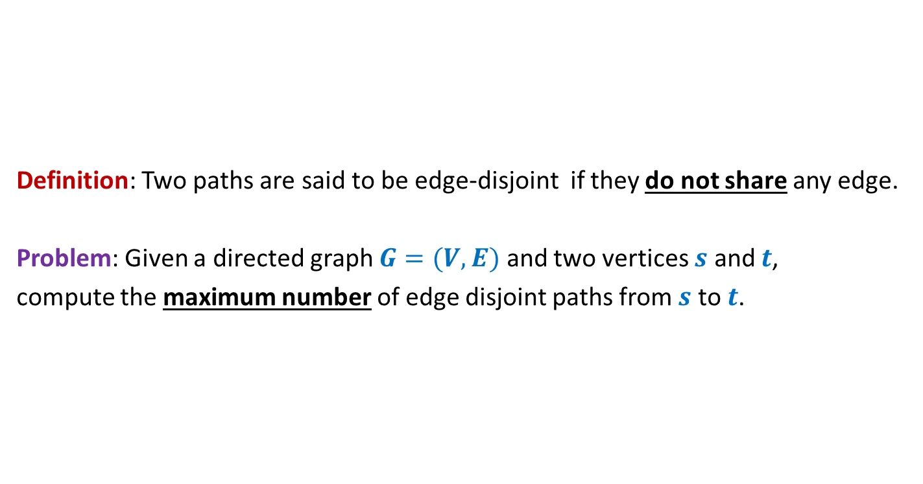
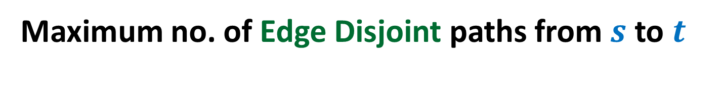
Maximum no. of Edge Disjoint paths from $s$ to $t$
Definition: Two paths are said to be edge-disjoint if they do not share any edge.
Problem: Given a directed graph $G=(V,E)$ and two vertices $s$ and $t$,
compute the maximum number of edge disjoint paths from $s$ to $t$.

Slide 31




Maximum no. of Edge Disjoint paths from $s$ to $t$
Intuition: View $G$ as a flow network, and compute max-flow from $s$ to $t$.
Question: What will be capacities of edges ?
Answer: unit capacity.
Question: What relationship exists between the two instances ?
A natural guess/intuition➔
maximum no. of $s$-$t$ paths in $G$ = max-flow from $s$ to $t$in the corresponding flow network.
$$G$$
$$s$$
$$t$$

Slide 32

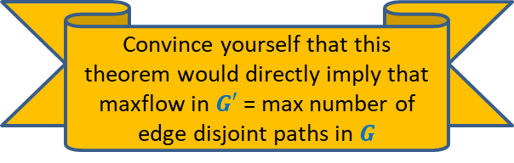
Maximum no. of Edge Disjoint paths from $s$ to $t$
Theorem:
There are $k$ edge disjoint paths from $s$ to $t$ in $G$
if and only if
there is a flow of value $k$ from $s$ to $t$in corresponding flow network
$$G$$
$$s$$
$$t$$
Convince yourself that this theorem would directly imply that
maxflow in $G′$ = max number of edge disjoint paths in $G$

Slide 33
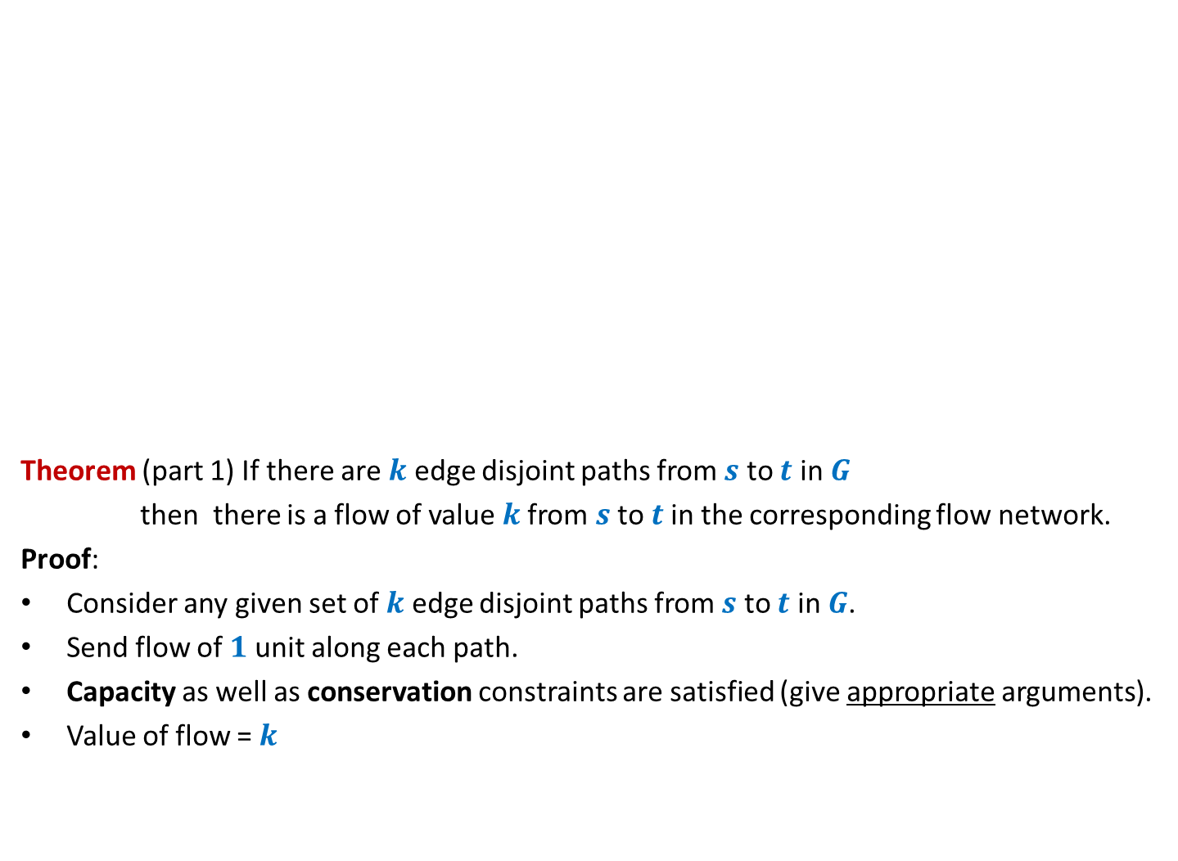
Maximum no. of Edge Disjoint paths from $s$ to $t$
Theorem (part 1) If there are $k$ edge disjoint paths from $s$ to $t$ in $G$
then there is a flow of value $k$from $s$ to $t$in the corresponding flow network.
Proof:
Consider any given set of $k$ edge disjoint paths from $s$ to $t$ in $G$.
Send flow of $1$ unit along each path.
Capacity as well as conservation constraints are satisfied (give appropriate arguments).
Value of flow = $k$
$$G$$
$$s$$
$$t$$

Slide 34

Maximum no. of Edge Disjoint paths from $s$ to $t$
Theorem (part 2) If there is a flow of value $k$from $s$ to $t$in the flow network
then there are $k$ edge disjoint paths from $s$ to $t$ in $G$.
Proof:
and
➔there exists a flow $f$ of value $k$such that $f \left(e\right)=1$or $0$for all $e∈E$.
Aim: To construct $k$ edge disjoint paths from $s$ to $t$ using edges carrying unit flow.
$$G$$
$$s$$
$$t$$
Integrality of flow
Unit edge capacity

Slide 35

Maximum no. of Edge Disjoint paths from $s$ to $t$
Theorem (part 2) If there is a flow of value $k$from $s$ to $t$in the flow network
then there are $k$ edge disjoint paths from $s$ to $t$ in $G$.
Proof: “Keep following any stream of flow originating from $s$ and terminating at $t$”.
What if we get caught in a loop ☹?
But is it possible in a flow ?
Yes, INDEED.
$$G$$
$$s$$
$$t$$

Slide 36

Maximum no. of Edge Disjoint paths from $s$ to $t$
Theorem (part 2) If there is a flow of value $k$from $s$ to $t$in the flow network
then there are $k$ edge disjoint paths from $s$ to $t$ in $G$.
$$G$$
$$s$$
$$t$$
Using the last animation as a hint,
make sincere attempts to prove this part of Theorem.
It is given on the following slide.

Slide 37
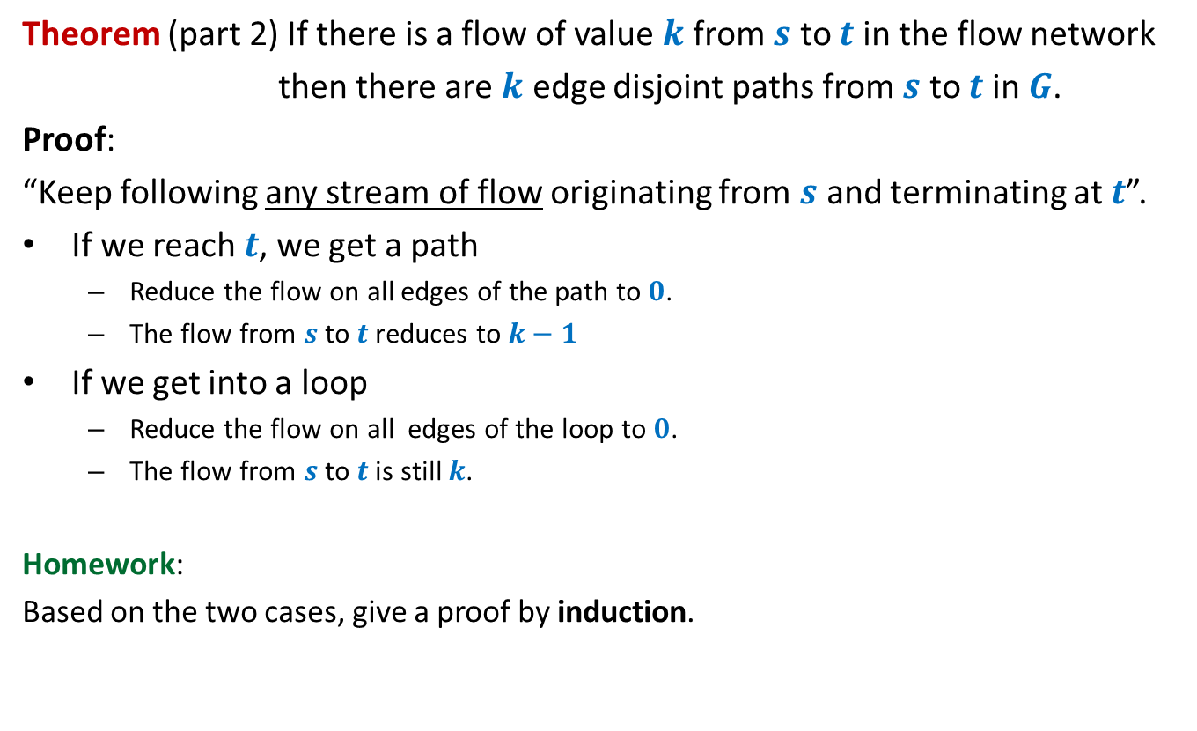
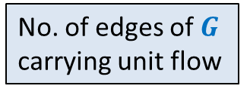


Maximum no. of Edge Disjoint paths from $s$ to $t$
Theorem (part 2) If there is a flow of value $k$from $s$ to $t$in the flow network
then there are $k$ edge disjoint paths from $s$ to $t$ in $G$.
Proof:
“Keep following any stream of flow originating from $s$ and terminating at $t$”.
If we reach $t$, we get a path
Reduce the flow on all edges of the path to $0$.
The flow from $s$ to $t$reduces to $k−1$
If we get into a loop
Reduce the flow on all edges of the loop to $0$.
The flow from $s$ to $t$is still $k$.
Homework:
Based on the two cases, give a proof by induction.
What will you induct on ?
No. of edges of $G$
$k$
No. of edges of $G$
carrying unit flow

